Slide 1
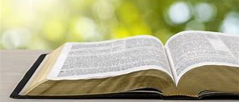
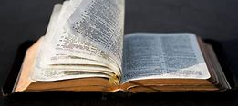
Meditating on God's Word (Part Two)
Pastor Felix BAKE

Slide 2
The goal of your meditation…
Understand what God want to tell you through the Bible

Slide 3
The Holy Spirit is the true author of the Bible (2Tim3:16)
For teaching
Rebuking
Correcting and
Training in righteousness

Slide 4
Dispositions to have before meditating on the word of God…
Have the love of meditating (Ps119:97)
Have the pleasure of being faced with the word of God (Ps1:2)
Be ready to let yourself be taught or corrected by the word (Ps119:12)
Have an open mind (Quiet place)
You will need your book note and a pen/pencil

Slide 5
Steps to fallow during meditating…
Pray for the Holy Spirit to open your understanding (Luke 24:45)

Slide 6
Steps to fallow during meditating…
Ask the Holy Spirit to be your teacher

Slide 7
Steps to fallow during meditating…
Have at least two different versions of the Bible to read

Slide 8
Steps to fallow during meditating… Steps to fallow during meditating…
Read the verse aloud at least twice (Rev 1:3)

Slide 9
Steps to fallow during meditating…
Read the third time in your heart
Paying attention to difficult words
Read the context (previous verses and following verses)
Read other translations to better understand the words

Slide 10
Ask yourself the following questions ….
Does the text speak of God the father, son or Holy Spirit?
If not, who or what is the text talking about?
Is there a sin to confess?
Is there an example not to follow?

Slide 11
Look for something to put into practice..
Write in your notebook
Pray to ask the Holy Spirit to help you love the word

