Slide 1
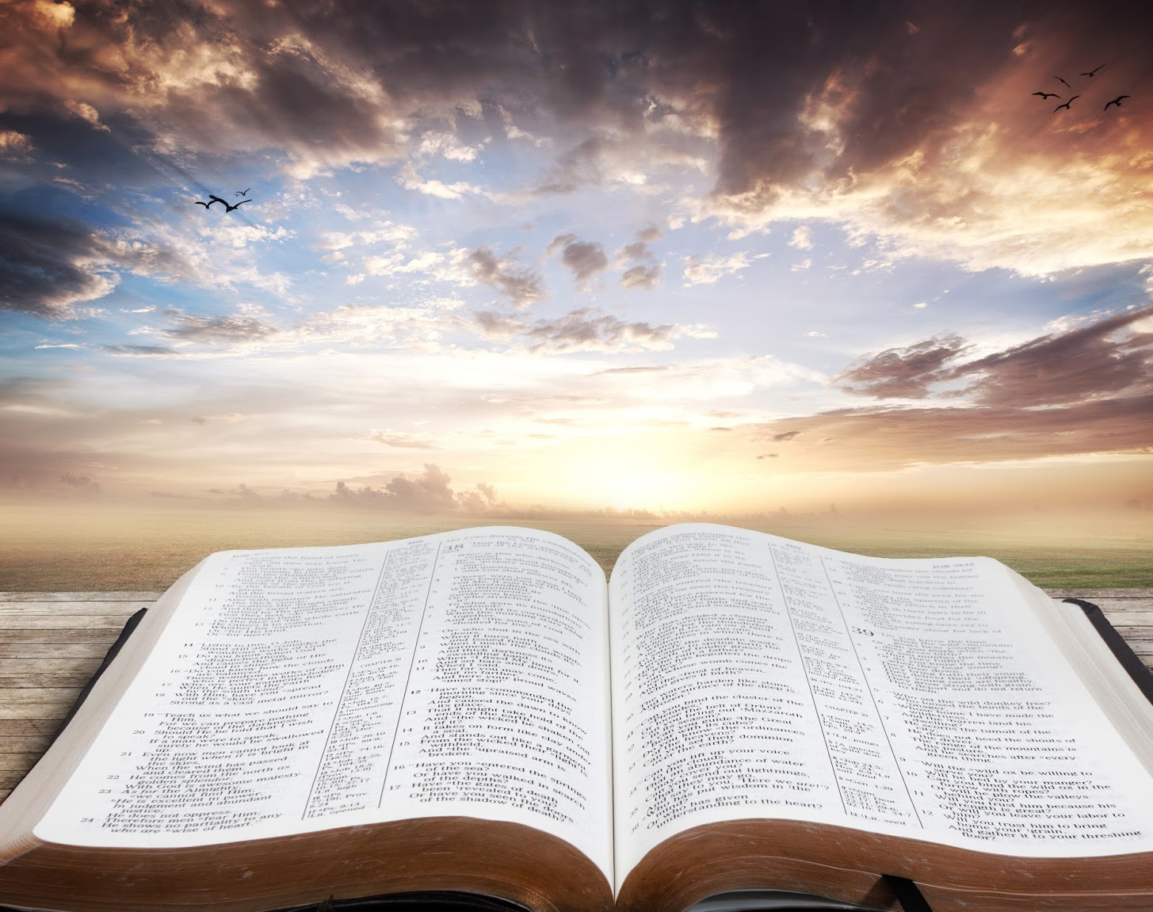
Meditating on God's Word
Joshua 1:7-8
Pastor Felix BAKE

Slide 2
What is the difference between reading and meditating on the word?
Listen
Understand in depth
Ex Luck 18:25

Slide 3
Why is it important to understand the Word?
Rev 1:3
Example: Acts 8:29 - 38

Slide 4
Jesus says the Word of God is Food…
Matt 4:4
Ezekiel 3:1

Slide 5
Two types of spiritual food
Heb 5:13-14

Slide 6
What does it mean to meditate day and night?...
Psalm 1:2-3

Slide 7
Why is it important to meditate on the word?...
Builds our faith (Romans 10:17)
Brings our soul back to life (Psalms 19:8)
It gives us victory in the spiritual world (Ephesians 6:17)
The word of God is a source of oxygen (Psalm 1:3)

Slide 8
Why is it important to meditate on the word?...
Sanctifies us (John 17:17)
Heals us (Proverbs 4:20-22)
Comforts us (Romans 15:4)
Fills us with joy (Psalms 119:11)

Slide 9
What is the result in life for one who meditates on the Word of God?
Joshua 1:8

