Slide 1
What do we need to know about sects?
Pastor Felix Bake, Good News Church
Snellville

Slide 2
SECTS
Definition:
Group of people who have a particular doctrine within a religion or organization. The members adhere to this doctrines.

Slide 3
What is the Christian definition of sects?
Teaching contradicts orthodox Christian doctrines
Most of their doctrines lead to perdition as mentioned in 2 Peter 2.1.
Members are considered heretics
They teach heresies
Having a different view of Jesus, the Holy Spirit compared to what the bible teach

Slide 4
Example of Sects among the Jews
The Pharisees (Acts 26: 5)
The Sadducees (Acts 5:17)
The Essenes
The early Christians were themselves considered a Judaic sect (Acts 24: 5; 24:14)
Judaism- Christiasm and Catholism- Protestantism

Slide 5
Example of Sects of Christian Origin
Jehovah's Witnesses,
Mormons,
Seventh-day Adventists,
Christian science.
The Church of Scientology
Children of God/Family of Love
Moon Sect / Unification Church
Church of Euthanasia

Slide 6
SECRET SOCIETY
Freemason
Illuminati
KKK ( Ku Klux Klan)
The Skull and Bone (322)
The Rosicrucian
Les Assassins

Slide 7
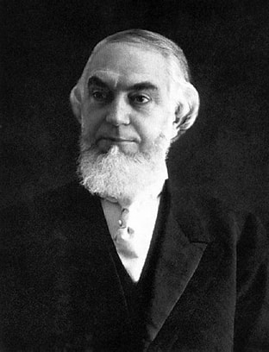
Charles taze russel
Founder of JohovahWitnesses
Born in 1852, in Pennsylvania
Student of the Bible, created watchtower
Died in 1916 by a train accident

Slide 8
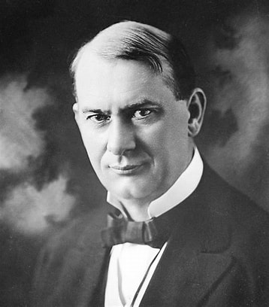
Joseph franklin Rutherford 1869 - 1942

Slide 9
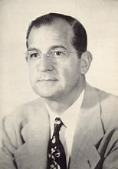
NATHAN HOMER KNORR 1905 - 1977

Slide 10
Why do we need to know about Sects?
They are dangerous for our faith They
Divide the Church of Jesus
Teaches false doctrines
Prevent us to receive eternal life in Jesus

Slide 11
The Fundamental Believes of JW
Jesus is Not God
He was the first creature created by the Father ( Jehovah)
All the other creations were created by Jesus
Jesus is the archangel Michael
Jesus died on the pole and not on the cross
Jesus did not resuscitate physically
Jesus has already returned since 1914
The Holy Spirit is not God
The Holy Spirit is the working force of God

Slide 12
HOW THE JEHOVAH WITNESSES SEE GOD
Jehovah is the only God
Jesus is the First creature of God
The Holy Spirit is the working power of God
Don’t Believe on the Trinity

Slide 13
The fundamental Believes of JW Con’t
No hell or the judgment of sinners
They believe in two hopes: celestial life for 144,000
Earthly life for all other men
Only the 144,000 elected can participate in the holy communion, organized once a year.
They don't celebrate Christmas
They don't celebrate birthdays
No blood transfusion

Slide 14
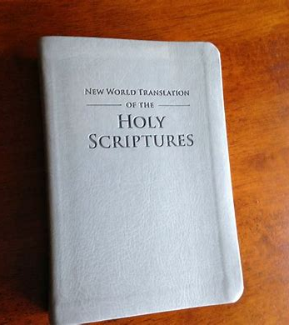
Their Literature
Have their own Bible
The New World Translation
They have distorted the Bible
The interpretation benefit their organization

Slide 15
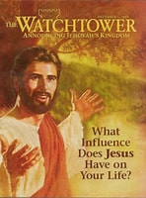
Their Literature
The main journal where they express their thoughts
Used to promote their doctrines
They have other books

Slide 16
The false Doctrines of JW
The organization takes his foundation on men (1Cor3: 11; Ga1:8)
Jesus has returned since 1914 (Mt24: 36; Phil 3:20
The coming Jesus was invisible (Mt24: 30; Rev1: 7; Ac1: 11
To be saved one must belong to the organization (Ro 10; 9)
Do not accept the divinity of Jesus, he is not equal to the father (Jn10: 28 = Ps 95: 7 Det 32:39) - What Jesus declares (Jn 5:18) equal to the father Jesus is not created, he is the creator as the father (Neh9: 6-7; 1Cor8: 6)

