Slide 1
God Gave You Authority!
Luke 10:19

Slide 2
The Bible has the authority to judge all cultures
God chose the Jewish nation to make himself known to other nations (Ge12:3)
Jewish culture began with Abraham (Lev 19:2)
God really revealed himself to other nations through Jesus (Jn1:18)

Slide 3
God’s order of submission
God (The father, Son, and Spirit)
Archangel
Angels
The Body of Christ (Ps8:4-5)
Husband (1 Cor 11:3)
Wife( Ep 5:22)
Children (Col 3:20; Ep 6: 1-3)
Leaders(teacher)
Members(Heb 13:17)
Employer
Employee ( Col 3:22; 1P2:18)
Government
Citizen( 1 P2:13; Ro13:1,5)

Slide 4
The goal of God’s order of submission
Avoid disorder and confusion (1Cor 14:32-33)
Have a life of obedience( Ro13:1)
Avoid dictatorship, encourage love

Slide 5
Why Satan fights against God's order?
He is a rebel from the beginning (Is 14:15)
He wants power (Mat 4: 8-9)
He wants to take away your power ( 1P5:8)

Slide 6
Example in the Bible…
David vs Saul ( 2Sa 1:1-15)
Abraham vs Sarah ( 1P3:6)
Joseph vs Potiphar ( Ge 39: 8-9)

Slide 7
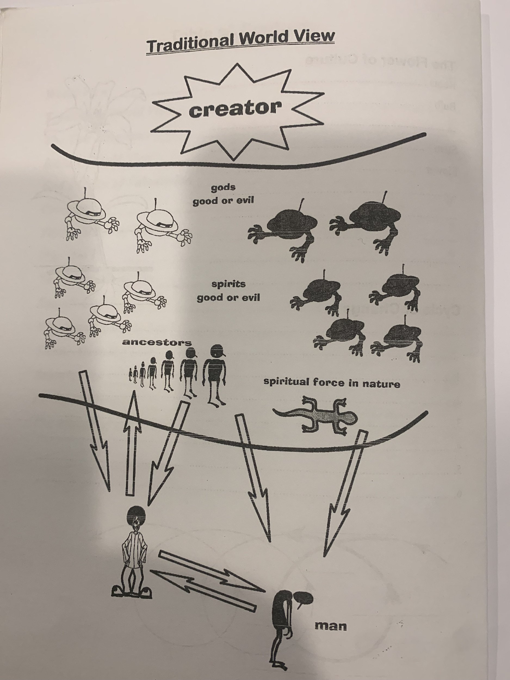
Traditional world view (One kingdom)

Slide 8
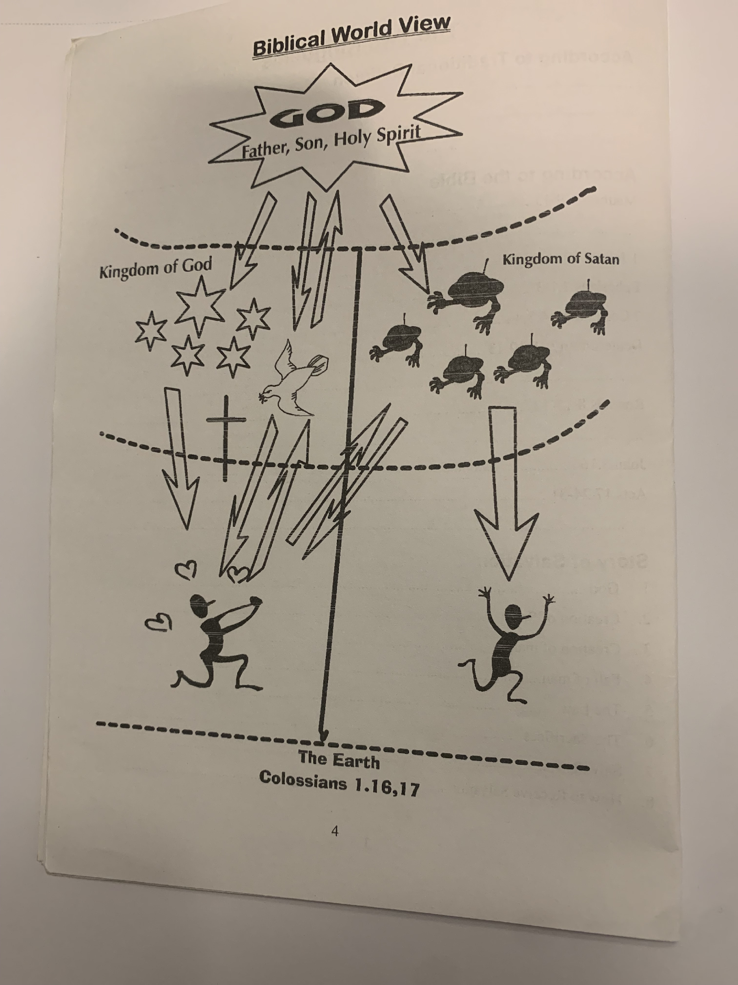
Biblical view ( Two kingdoms)

Slide 9
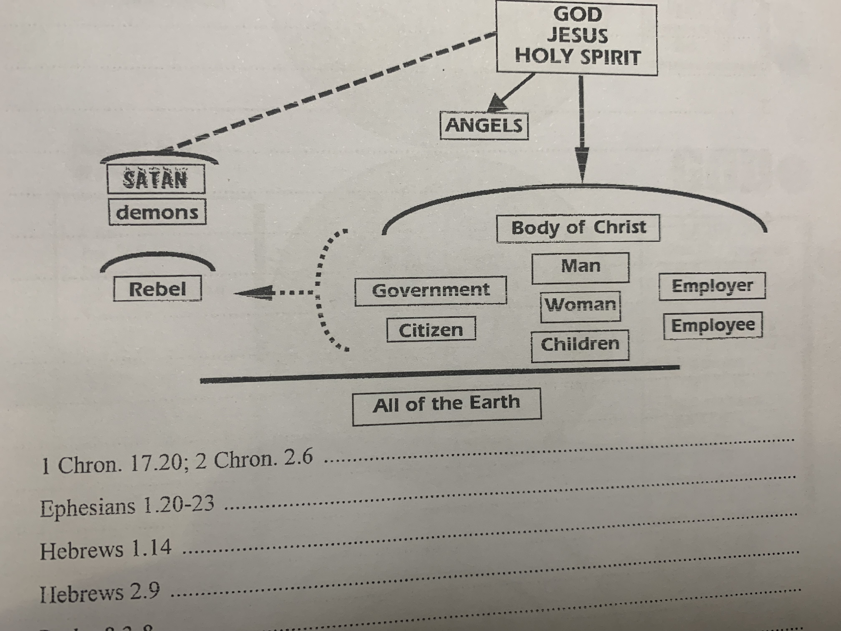
Fail to obey God’s order of Submission

Slide 10
H

