Slide 1
How can a young man keep his way pure? ( Ps 119:9)
Pastor Felix BAKE

Slide 2
What is the purpose of which God created man and woman? Ge 1:26-28
To have dominion over the creation
Be fruitful, multiply and fil the earth

Slide 3
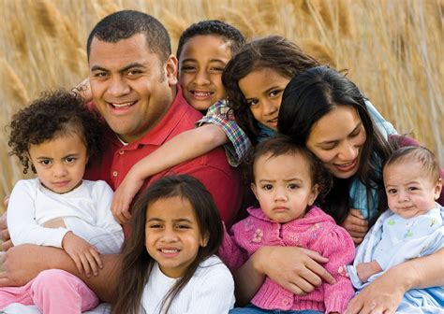
How do you understand Proverbs 16:4?
The Lord has made everything for its own purpose
How man and woman will multiply and fil the earth

Slide 4
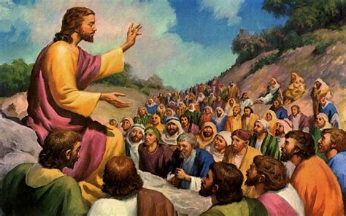
What did Jesus want to tell us in Mat 15:17?
The body has many tubes
Explained the functions of the body
Where the waste materials go out of the body

Slide 5
Adam & Eve vs The People of Sodom
Adam and Eve gave birth to a child (Ge 4:1-3)
The people of Sodom against God’s purpose (Ge 19: 4-5)

Slide 6
What is the meaning of sodomy?
The word sodomy comes from the name of the city called Sodom in Genesis 19
A sexual act regarded as perverted
A sexual act in a manner against nature

Slide 7
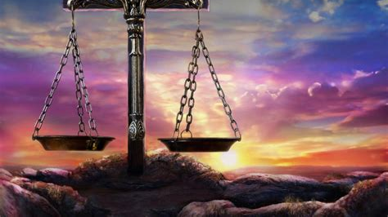
What does the bible call shameful lusts.?Ro1:26-27
Exchanged natural sexual relations for unnatural ones
Men abandoned natural relations with women
Men committed shameful acts with other men

Slide 8
The scientific justification vs The Bible
https://youtu.be/EEeMCNwowJg

Slide 9
Some terminologies
Bisexual: sexual attraction, or sexual behavior toward both males and females.
Pansexual: Someone attracted to all kinds of people, regardless of their gender, sex or presentation.
Transexual: A personne having undergone medical treatment to become a member of the opposite sex.

Slide 11
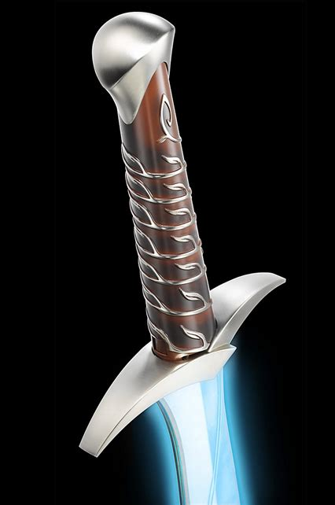
THE CONSEQUENCE OF BEING A SODOMIST
God forbids relations between man and man or woman and woman ( Lev.18:22)
The consequence is death (Lev.20:13)

Slide 12
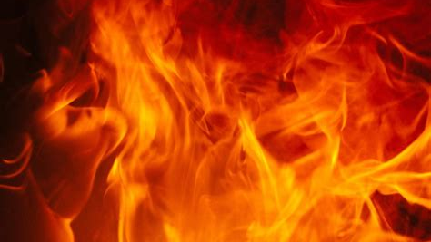
THE CONSEQUENCE OF BEING A SODOMIST
Punishment of eternal fire
(Jud: 1:7)

